Slide 1
108A-9 狂犬病

Slide 2
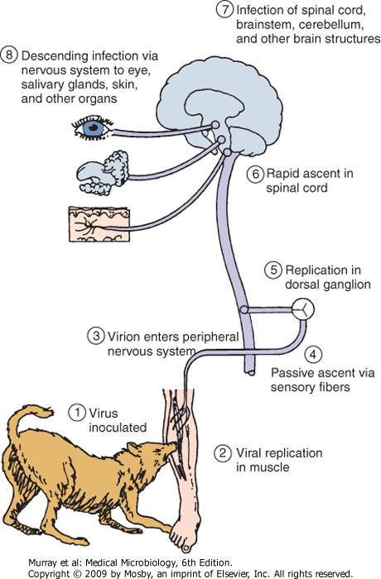
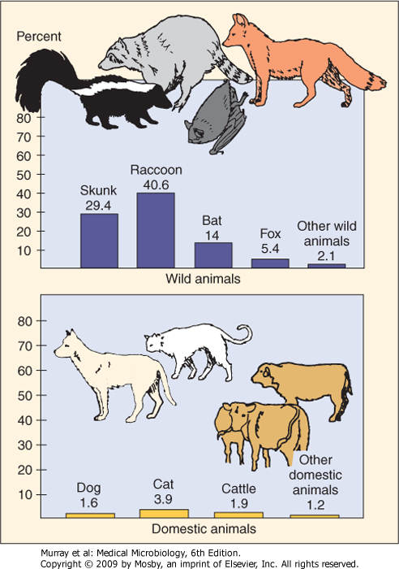
Pathogenesis of rabies virus infection
23.2 34.9 26.4 6.6 2-----2008
1.1 4.3 0.9 0.6-----2008
Distribution of animal rabies in the United States, 1999. The percentages relate to the total number of cases of animal rabies. Cats are not vaccinated in the US.

Slide 3
Little House on the Prairie- The Raccoon

Slide 4
Rhabdoviridae Diseases
Vesiculovirus – many are arboviruses
Vesicular stomatitis virus – cattle, horses, swine; vesicular lesions of tongue, gums, hooves; resembles FMDV; can infect humans associated with animals causing flu-like mild disease
Lyssavirus – Spread by bloodstream contact with infected animal fluids (saliva in animal bite or inhalation of wastes)
Rabies – only mammals are significant hosts; slow incubation leading to acute encephalitis; Incubation from ~1 week to years with average of 1-2 months; Close proximity of bite to brain increases likelihood of death in untreated cases (face/head>arms>legs); Symptoms begin as febrile-flu like illness and progress to “neurologic phase” including hypersalivation, hyperactivity (“furious rabies”), delirium, paralysis (“dumb rabies”), hydrophobia (overactive gag reflex coincident with delirium); Symptoms are due to virus replication in neurons; Untreated survival after neurologic phase has never been documented
The Girl who survived rabies 13 min 28 sec

Slide 5
108A-9 デング熱

Slide 6
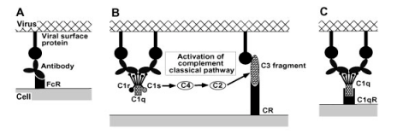
Antibody-dependent enhancement (ADE) of viral infection
Secondary dengue virus-2 infection after primary dengue virus-1 infection is a risk factor for dengue shock syndrome
Antibodies pre-existing from primary dengue virus infection enhance the replication of the second infecting dengue virus serotype
The virus-antibody complex can bind to cells bearing FcR (monocytes, macrophages, B cells and granulocytes) in flavivirus infection
Complement receptors involvement (flavivirus, HIV, Ebola virus)

Slide 7
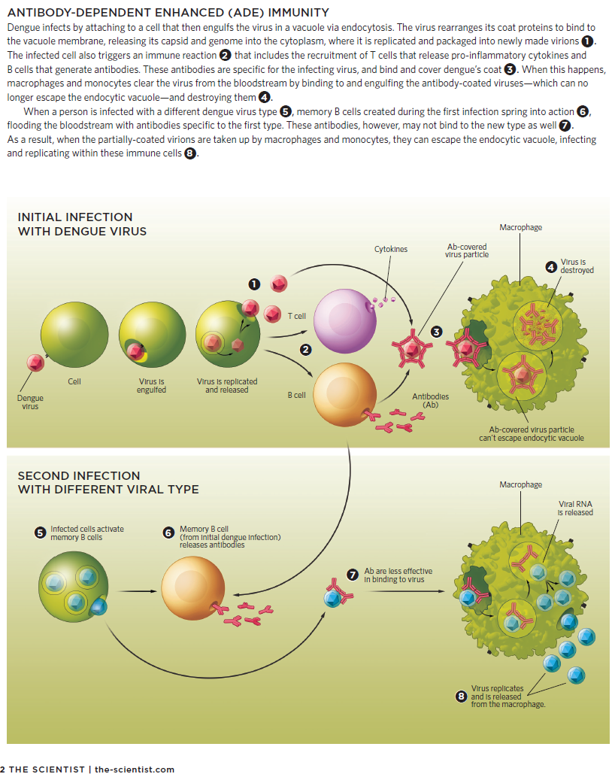
from neutralization, infecting

Slide 8
Antibodies are less effective in neutralizing virus

Slide 9
108I-15 腸炎ビブリオ Vibrio parahaemolytics
シンプル微生物学５版 ｐ133
神奈川現象： ヒト胃腸炎由来の腸炎ビブリオ株の多くは血液を加えた我妻培地上で溶血を示す
耐熱性溶血毒TDHにより溶血作用や致死作用を有する
http://www.pref.mie.lg.jp/hokan/hp/09900007454.htm

Slide 10
108I-27 プリオン病

Slide 11
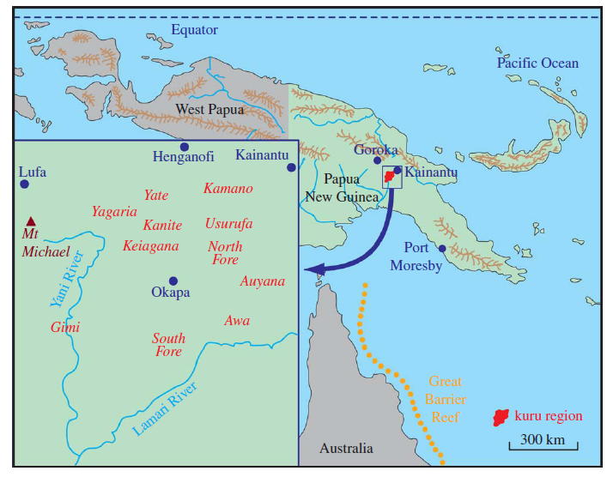
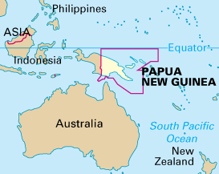
Kuru
1950s: Discovered in the Okapa district of Papua New Guinea, in the Fore people
Common in children and adult females with only 3% of adult male cases
A fatal progressive disease, average duration of the illness is 1 year
Ataxia, tremor
kuru = “shake from fear” in
the Fore language
Notes:
Fore フォーレイ

Slide 12
Kuru-Symptoms
Ambulant: Dysarthria
Cerebellar ataxia
Shivering-like tremor
Sedentary: Can’t walk without support
Severe tremors and ataxia
Rigidity of limbs and myoclonus
Terminal: Total loss of speech
Complete motor incapacity
Incontinence
Emaciation
Hypostatic pneumonia
Death
Notes:
hypostatic pneumonia
noun
Medical Definition of HYPOSTATIC PNEUMONIA
: pneumonia that usually results from the collection of fluid in the dorsal region of the lungs and occurs especially in those (as the bedridden or elderly) confined to a supine position for extended periods

Slide 13
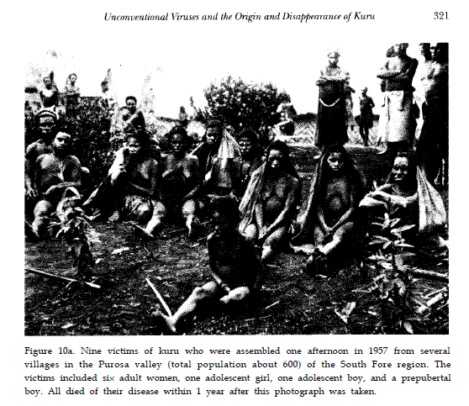

Slide 14
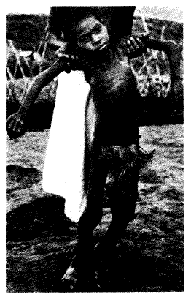
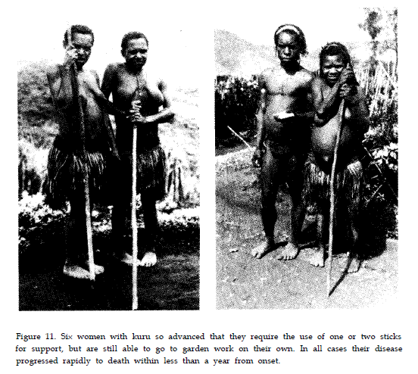

Slide 15
Epidemiology-ritual Cannibalism
Brains of dead people were eaten by their relatives (except adult males)
Women did autopsies bare-handed, leading to conjunctival, nasal, skin, and mucosal contamination
No children born after cannibalism ceased have developed kuru
Mean incubation period in kuru: 12 years (some case over 50 years)
Notes:
can·ni·bal·ism/kæn ə bəˌlɪz əm/

Slide 16
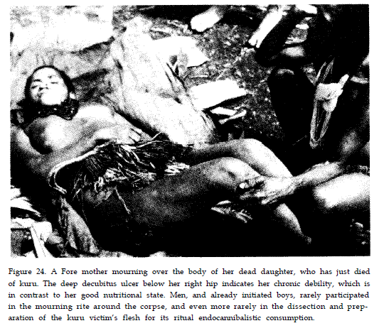

Slide 17
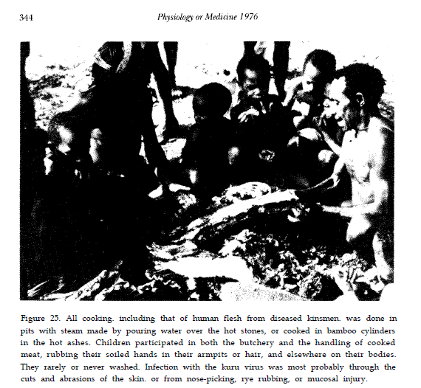
“If the body was buried it was eaten by worms; the Fore believed it was much better that the
body was eaten by people who loved the deceased than
by worms and insects.”

Slide 18
Kuru: The Science and The Sorcery
http://www.youtube.com/watch?v=vw_tClcS6To

Slide 19
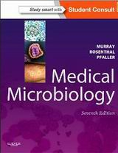
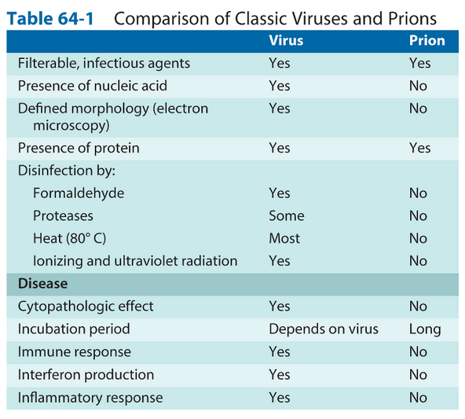

Slide 20
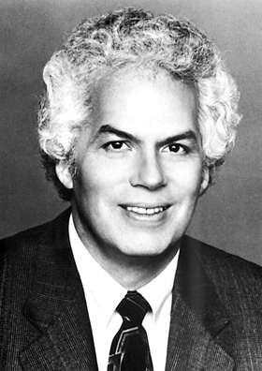
Stanley Prusiner (1942- )
The Nobel Prize in Physiology or Medicine 1997
Prize motivation: "for his discovery of Prions - a new biological principle of infection"
http://nobelprize.org/mediaplayer/index.php?id=441

Slide 21
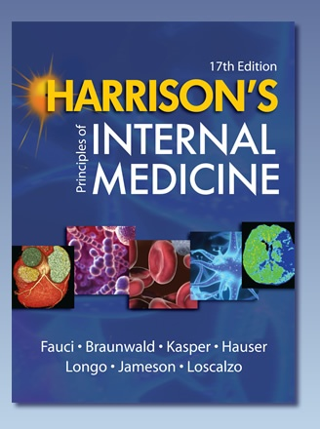
Prion definition
Proteinaceous infectious particle that lacks nucleic acid
Prions are composed largely, if not entirely, of PrP^{Sc} molecules
Prions can cause scrapie in sheep and goats, and related neurodegenerative diseases of humans, such as Creutzfeldt-Jakob disease
Prusiner and Miller, 378 Prion Diseases, Harrison’s Internal Medicine 17th edition, p2646-2651

Slide 22
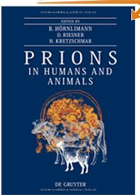
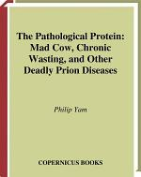
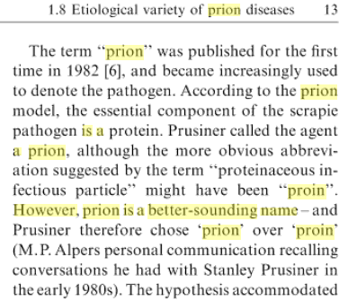
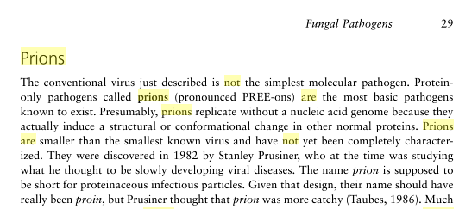
Information was provided by an LSU Medical Student, Ms. Brooke Richard, 2013
http://tsunodalaboratory.blog.fc2.com/blog-entry-122.html

Slide 23
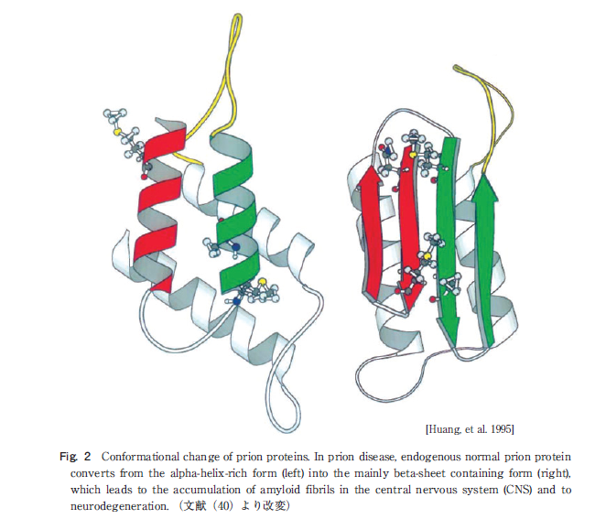
Structures of prion proteins
PrP^{C}, rich in α-helix
cellular prion protein
PrP^{Sc} , rich in β-sheet
scrapie-like prion protein)

Slide 24
108D-8
異常プリオン蛋白質の不活化法
処理方法 | 温度 | 時間
焼却
3% SDS | 100°C | 10分間
オートクレーブ | 134°C | 20分間
7 M塩酸グアニジン | 室温 | 2時間
3 Mグアニジンチオシアネート | 室温 | 2時間
3 Mトリクロロアセテート | 室温 | 2時間
60%ギ酸 | 室温 | 2時間
50%フェノール | 室温 | 2時間
1-5%次亜塩素酸ナトリウム | 室温 | 2時間
1 M水酸化ナトリウム | 室温 | 1時間

Slide 25
プリオン病-人獣共通感染症-
宿主 疾患名
ヒト クールー/Kuru
クロイツフェルト・ヤコブ病/Creutzfeldt-Jakob
disease, CJD
ゲルストマン・ストロイスラー・シャインカー症候
群/Gerstmann-Sträussler-Scheinker syndrome,
GSS
致死性家族性不眠症/Fetal familial insomnia, FFI
変異型クロイツフェルト・ヤコブ病/variant CJD
ヒツジ スクレイピー/Scrapie
シカ シカ慢性消耗病/Chronic wasting disease, CWD
ウシ ウシ海綿状脳症/Bovine spongiform
encephalopathy, BSE

Slide 26
Transmissible spongiform encephalopathy Neurodegenerative diseases
HOST DISEASE
Humans Kuru
Creutzfeldt-Jakob disease
Gerstmann-Sträussler-Scheinker syndrome
Fatal familial insomnia
Sporadic fatal insomnia (extremely rare)
Sheep/goats Scrapie
Cattle Bovine spongiform encephalopathy
Deer/elk Chronic wasting disease
Mink Transmissible mink encephalopathy

Slide 27
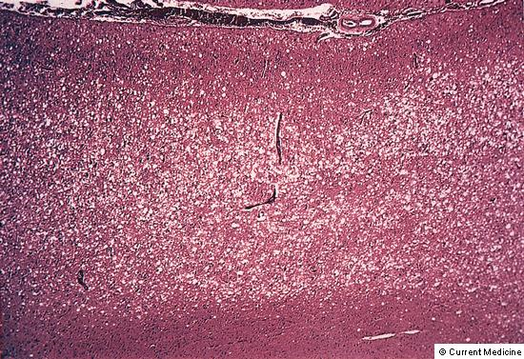
Prion disease: spongiform change
Spongiform change confined to gray matter, sparing of the white matter
The change be due to the development of vacuoles in the neurons
Hirano A. Color Atlas of Pathology of the Nervous System. Tokyo Igaku-Shoin, 1998;133-168.

Slide 28
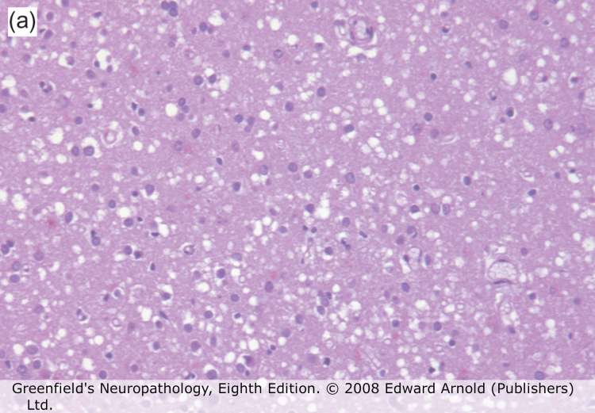
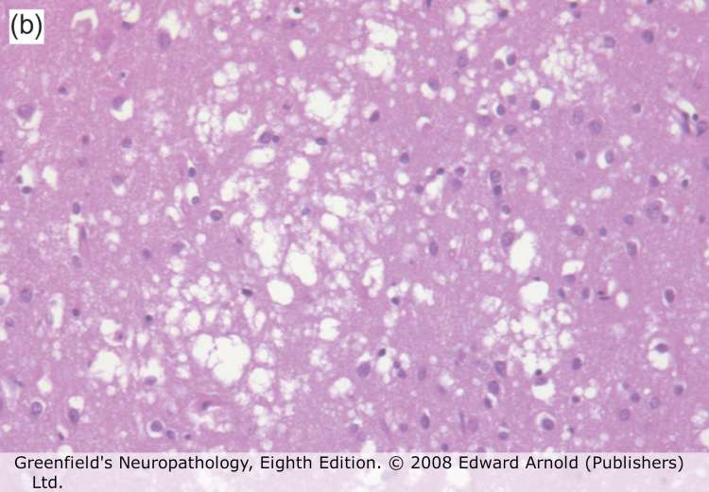
Spongiform change in Creutzfeldt-Jakob disease

Slide 29
Mad cow disease
http://www.youtube.com/watch?v=vw_tClcS6To
Kuru: The Science and The Sorcery

Slide 30
Variant CJD
Age of patients: ave. 27 years
Time between disease onset and death: 7-22 months
Extensive plaque formation; large amounts of prion protein
Plaques surrounded by spongiform lesions
Spongiform encephalopathy advisory committee: ‘Most likely explanation for these non-typical cases was exposure to BSE’
Genetic requirement for susceptibility

Slide 31
